Slide 1
Mean Variance Math and Some Offshoots
Mike Zwecher

Slide 2
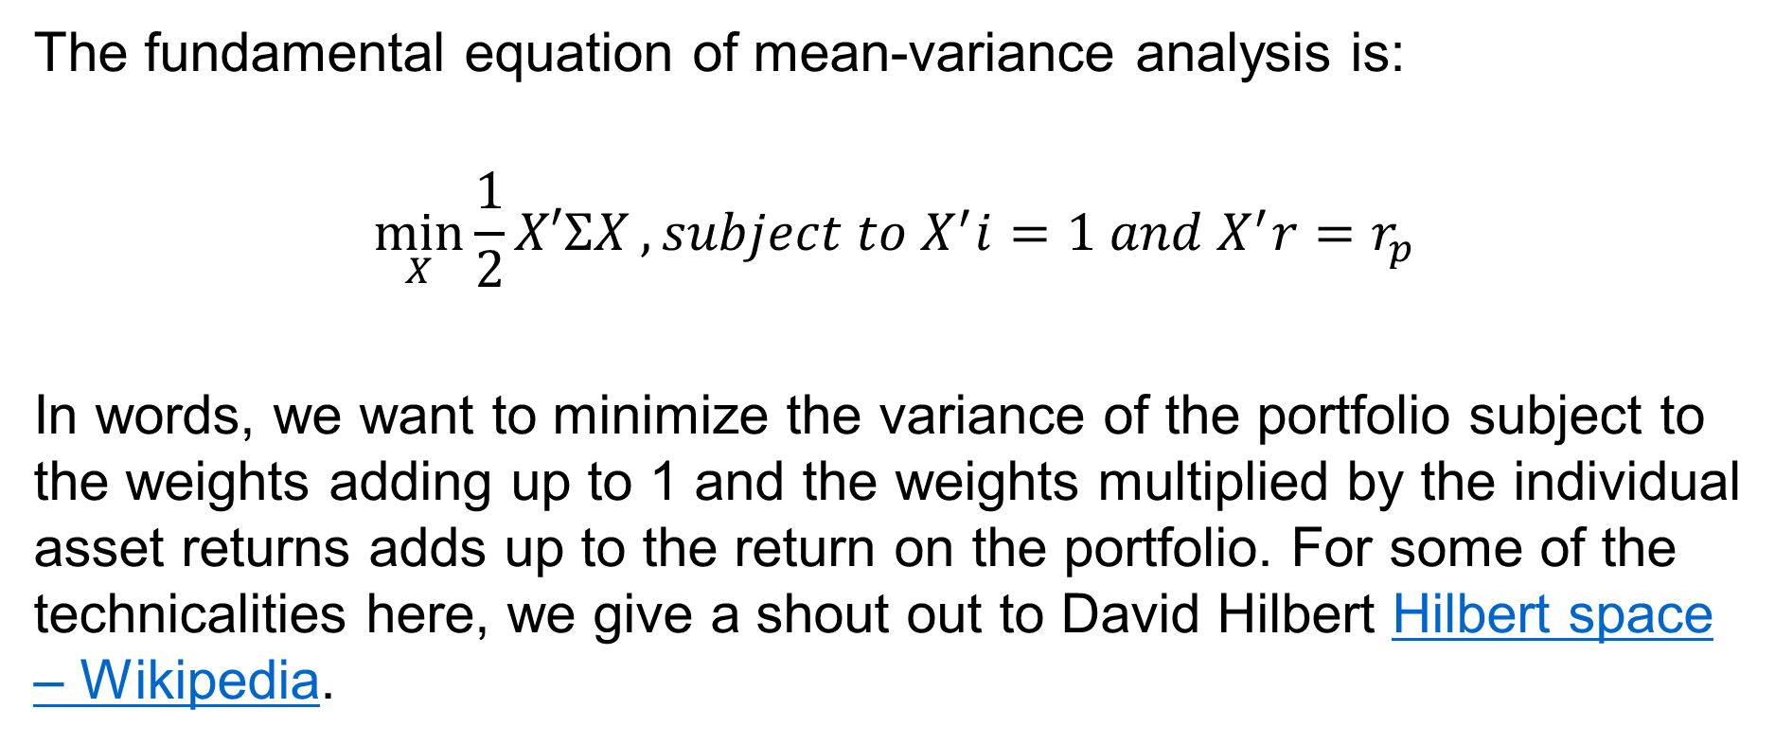
Mean-Variance Math
The fundamental equation of mean-variance analysis is:
$$\min_{X}{\frac{1}{2}X′ΣX}, subject to X^{′}i=1 and X^{′}r=r_{p}$$
In words, we want to minimize the variance of the portfolio subject to the weights adding up to 1 and the weights multiplied by the individual asset returns adds up to the return on the portfolio. For some of the technicalities here, we give a shout out to David Hilbert Hilbert space – Wikipedia.

Slide 3
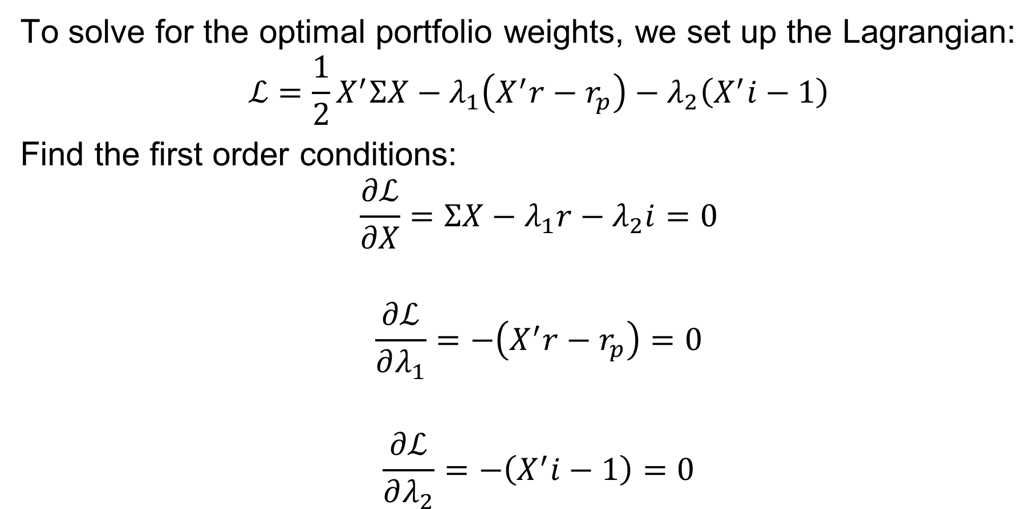
Mean-Variance Lagrangian
To solve for the optimal portfolio weights, we set up the Lagrangian:
$$ℒ=\frac{1}{2}X^{′}ΣX−λ_{1}\left(X^{′}r−r_{p}\right)−λ_{2}\left(X^{′}i−1\right)$$
Find the first order conditions:
$$\frac{∂ℒ}{∂X}=ΣX−λ_{1}r−λ_{2}i=0$$
$$\frac{∂ℒ}{∂λ_{1}}=−\left(X^{′}r−r_{p}\right)=0$$
$$\frac{∂ℒ}{∂λ_{2}}=−\left(X^{′}i−1\right)=0$$

Slide 4


Playing with the MV F/O/C
$$ΣX^{∗}=λ_{1}r+λ_{2}i$$
$$⇒X^{∗}=Σ^{−1}\left(λ_{1}r+λ_{2}i\right);$$
$${r′X}^{∗}=r_{p}$$
$⇒r^{′}Σ^{−1}\left(λ_{1}r+λ_{2}i\right)=r_{p}$
$$⇒{λ_{1}r}^{′}Σ^{−1}r+{λ_{2}r}^{′}Σ^{−1}i=r_{p}≡aλ_{1}+bλ_{2}$$
$${i′X}^{∗}=1$$
$$⇒i^{′}Σ^{−1}\left(λ_{1}r+λ_{2}i\right)=1$$
$$⇒{λ_{1}i}^{′}Σ^{−1}r+{λ_{2}i}^{′}Σ^{−1}i=1≡bλ_{1}+cλ_{2}$$
Define
$$a=r^{′}Σ^{−1}r$$
$$b=i^{′}Σ^{−1}r$$
$$c=i^{′}Σ^{−1}i$$

Slide 5
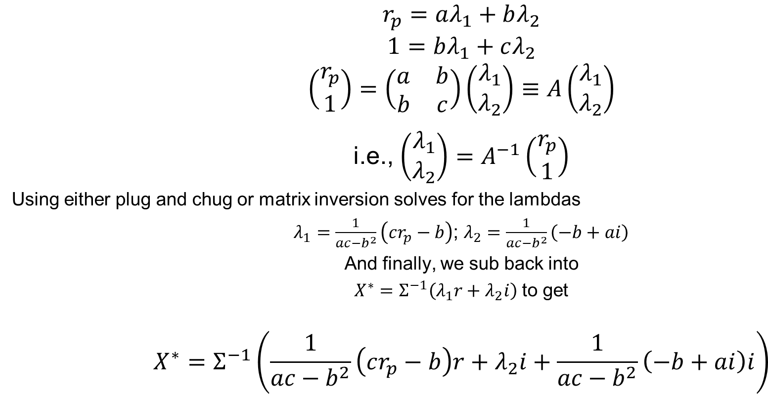
Solving out the Lambdas
$$r_{p}=aλ_{1}+bλ_{2}$$
$$1=bλ_{1}+cλ_{2}$$
$$\left(\begin{matrix}r_{p} \\ 1\end{matrix}\right)=\left(\begin{matrix}a & b \\ b & c\end{matrix}\right)\left(\begin{matrix}λ_{1} \\ λ_{2}\end{matrix}\right)≡A\left(\begin{matrix}λ_{1} \\ λ_{2}\end{matrix}\right)$$
i.e., $\left(\begin{matrix}λ_{1} \\ λ_{2}\end{matrix}\right)=A^{−1}\left(\begin{matrix}r_{p} \\ 1\end{matrix}\right)$
Using either plug and chug or matrix inversion solves for the lambdas
$λ_{1}=\frac{1}{ac−b^{2}}\left(cr_{p}−b\right)$; $λ_{2}=\frac{1}{ac−b^{2}}\left(−b+ai\right)$
And finally, we sub back into
$X^{∗}=Σ^{−1}\left(λ_{1}r+λ_{2}i\right)$ to get
$$X^{∗}=Σ^{−1}\left(\frac{1}{ac−b^{2}}\left(cr_{p}−b\right)r+λ_{2}i+\frac{1}{ac−b^{2}}\left(−b+ai\right)i\right)$$

Slide 6
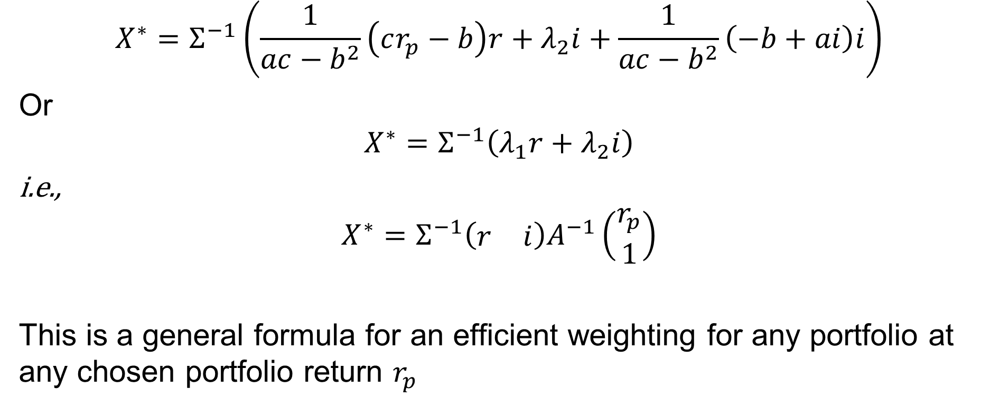
Cleaning things up a bit
$$X^{∗}=Σ^{−1}\left(\frac{1}{ac−b^{2}}\left(cr_{p}−b\right)r+λ_{2}i+\frac{1}{ac−b^{2}}\left(−b+ai\right)i\right)$$
Or
$$X^{∗}=Σ^{−1}\left(λ_{1}r+λ_{2}i\right)$$
i.e.,
$$X^{∗}=Σ^{−1}\left(\begin{matrix}r & i\end{matrix}\right)A^{−1}\left(\begin{matrix}r_{p} \\ 1\end{matrix}\right)$$
This is a general formula for an efficient weighting for any portfolio at any chosen portfolio return $r_{p}$

Slide 7
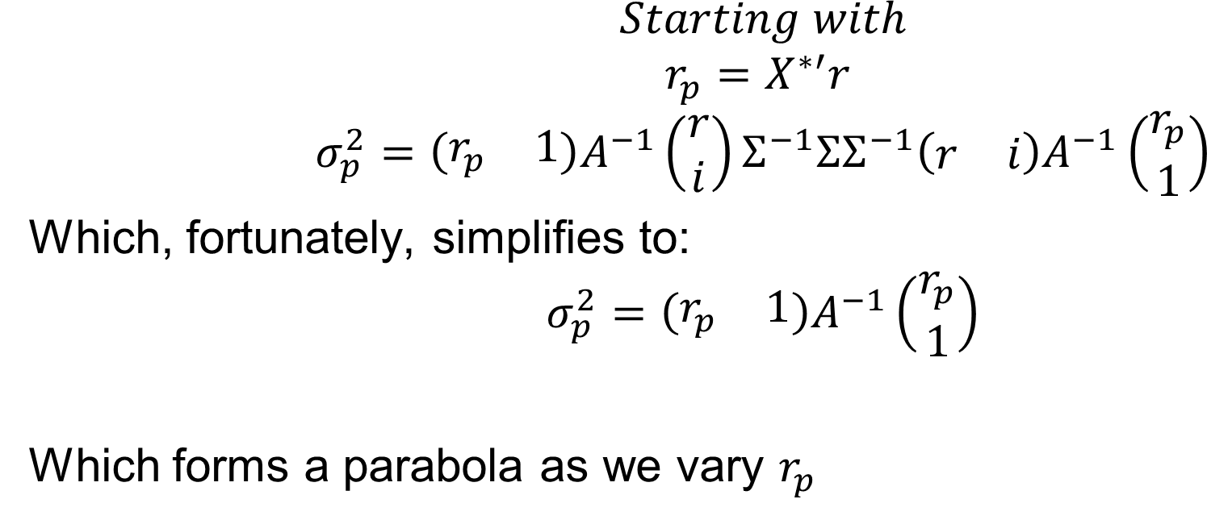
Variance of a MV-Efficient pPortfolio
$$Starting with$$
$$r_{p}=X^{∗′}r$$
$$σ_{p}^{2}=\left(\begin{matrix}r_{p} & 1\end{matrix}\right)A^{−1}\left(\begin{matrix}r \\ i\end{matrix}\right)Σ^{−1}ΣΣ^{−1}\left(\begin{matrix}r & i\end{matrix}\right)A^{−1}\left(\begin{matrix}r_{p} \\ 1\end{matrix}\right)$$
Which, fortunately, simplifies to:
$$σ_{p}^{2}=\left(\begin{matrix}r_{p} & 1\end{matrix}\right)A^{−1}\left(\begin{matrix}r_{p} \\ 1\end{matrix}\right)$$
Which forms a parabola as we vary $r_{p}$

Slide 8
CAPM
The sole prediction of the CAPM is that the market portfolio is efficient.
The covariance vector of individual assets with any portfolio can be expressed as an exact linear function of the individual mean returns vector if and only if the portfolio is efficient.
Without delving deeper into the above statements and going down the rest of the CAPM route at this point, let’s shoot off to alternatives

Slide 9
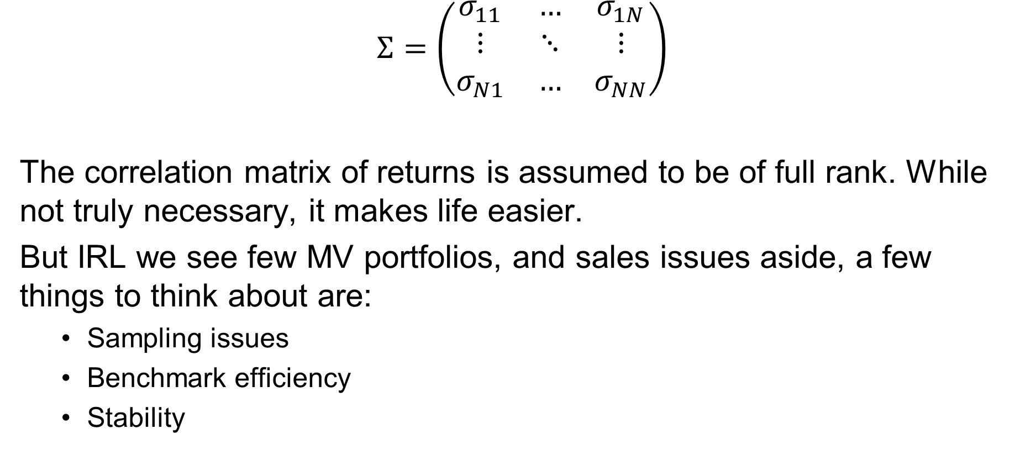
A Couple of Variance Problems
$$Σ=\left(\begin{matrix}σ_{11} & … & σ_{1N} \\ ⋮ & ⋱ & ⋮ \\ σ_{N1} & … & σ_{NN}\end{matrix}\right)$$
The correlation matrix of returns is assumed to be of full rank. While not truly necessary, it makes life easier.
But IRL we see few MV portfolios, and sales issues aside, a few things to think about are:
Sampling issues
Benchmark efficiency
Stability
Discussion

Slide 10
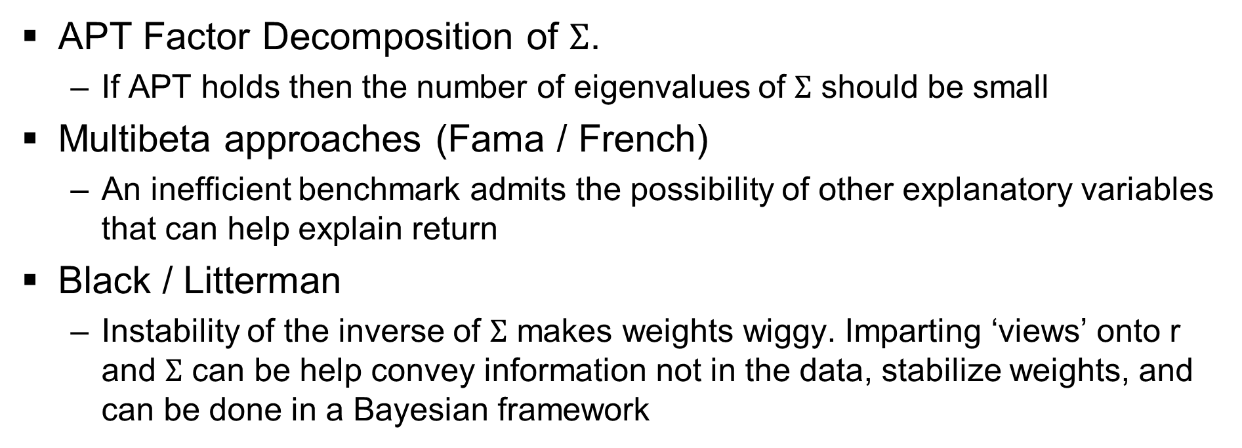
Alternatives to Strict CAPM
APT Factor Decomposition of $Σ$.
If APT holds then the number of eigenvalues of $Σ$ should be small
Multibeta approaches (Fama / French)
An inefficient benchmark admits the possibility of other explanatory variables that can help explain return
Black / Litterman
Instability of the inverse of $Σ$ makes weights wiggy. Imparting ‘views’ onto r and $Σ$ can be help convey information not in the data, stabilize weights, and can be done in a Bayesian framework

